Slide 1


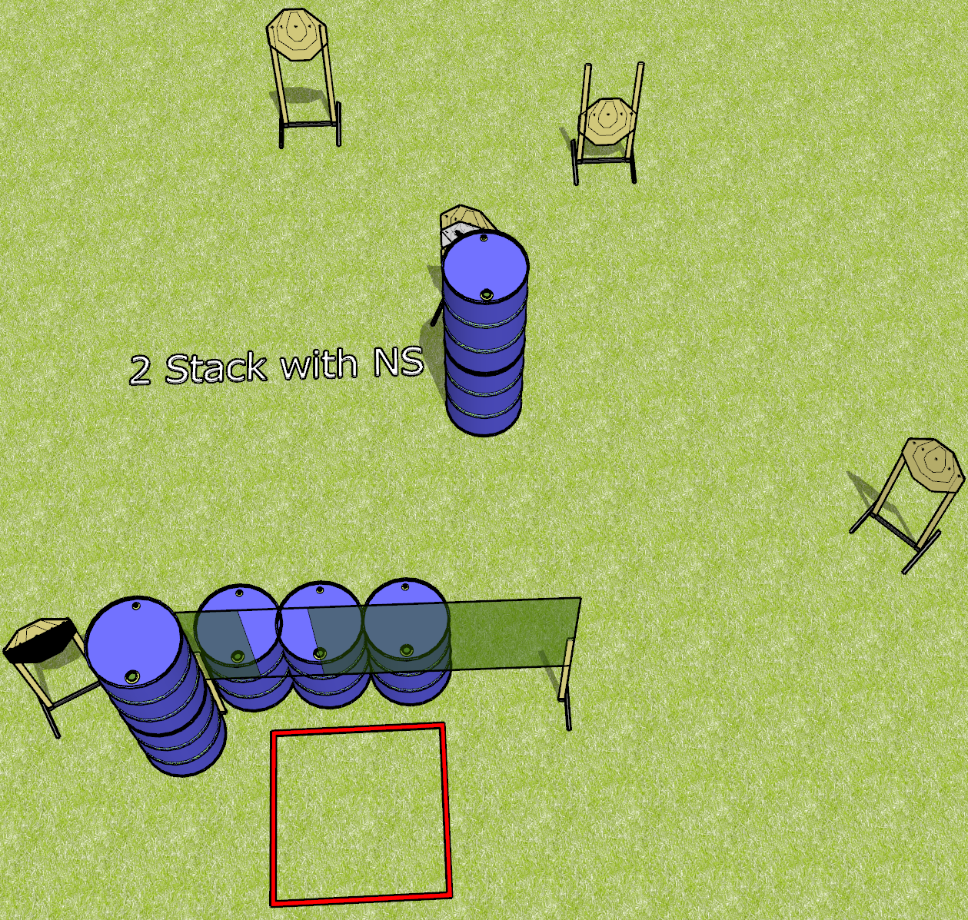
 | Dothan Gun Club – USPSA Match Ugly Course Designer : Drew Coleman
Round Count 18 rounds 6 IPSC
Equipment List 2 wall feet 1 4’ shooting box 1 50%

Slide 2
Ugly
Written Stage Briefing
Ugly is an 18 round, 90 point, Comstock course of fire. There are 6 IPSC targets. The best 3 hits will score.
Handgun start position is anywhere inside the shooting area, wrists below belt. Handgun is loaded and holstered.
PCC start position is anywhere inside the shooting area, stock on belt. Loaded carbine is held with both hands.
On the audible start signal, engage targets from within the shooting area. You may shoot under the wall.

